Slide 1
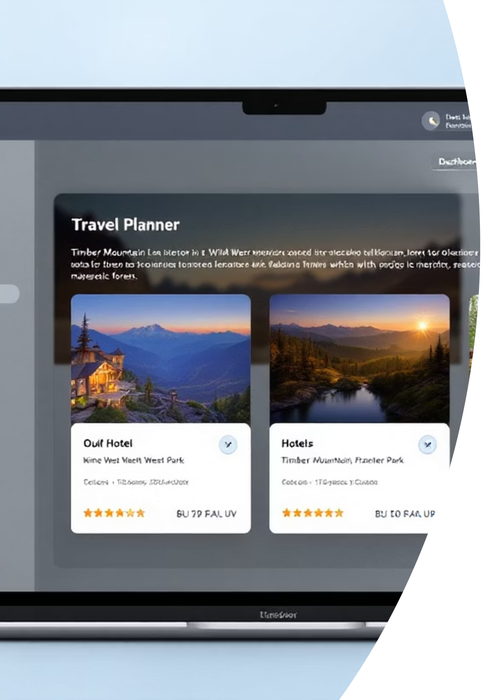

Wild Willy AI Planner: Trust & Adoption A/B Test Results
Our recent test adding verified star ratings to Wild Willy, our AI vacation planner, delivered compelling results that address key conversion challenges. This presentation explores how transparent social proof impacts user trust and itinerary creation rates for Timber Mountain vacations.
by Andre Rand

Slide 2
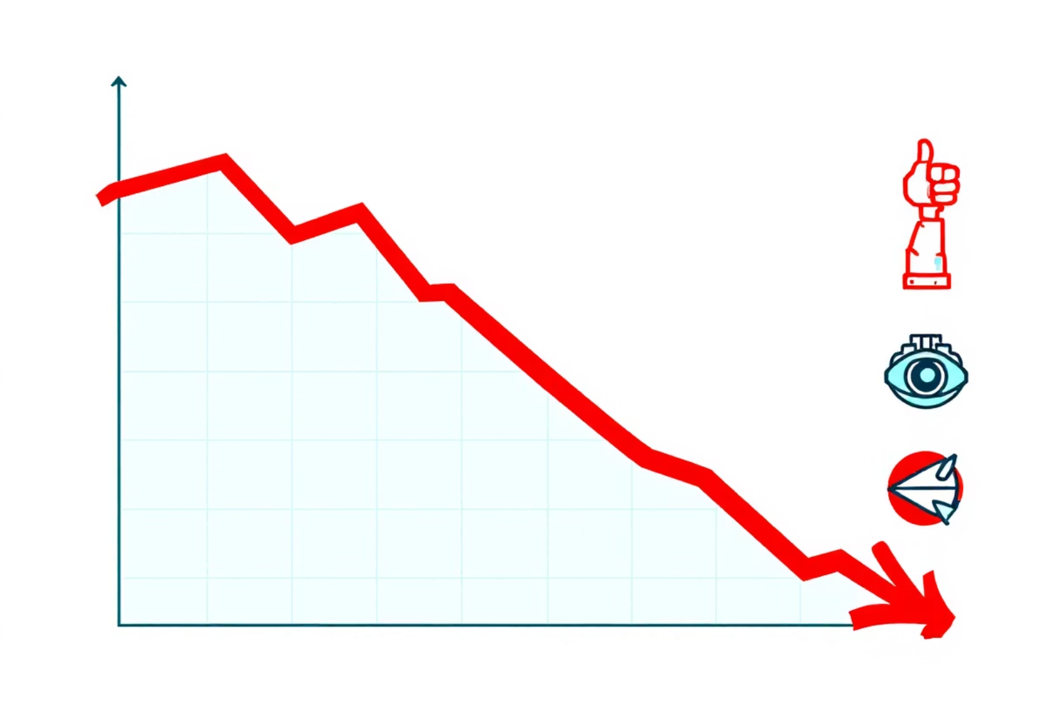
The Trust Gap Challenge
Current Engagement Metrics
30%
20%
Visitor Engagement
Itinerary Creation
Users who interact with Wild Willy AI planner
Engaged users who create an itinerary
3%
Conversion Rate
Survey data shows declining trust in Wild Willy's recommendations, creating a "black-box" transparency problem that prevents users from confidently accepting AI suggestions.
Overall ticket purchase conversion

Slide 3
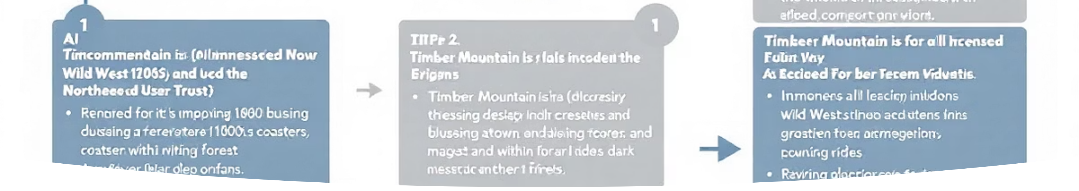
Our Hypothesis: Social Proof Builds Trust
Displaying verified 1-to-5-star guest ratings beside every hotel and flight card will raise the itinerary-creation rate by at least 8%, because ratings transform opaque AI recommendations into peer-endorsed suggestions.
We identified trust as the key friction point on page 13 of our case study and theorized that transparent social validation would significantly impact user confidence in our AI planner's recommendations.

Slide 4

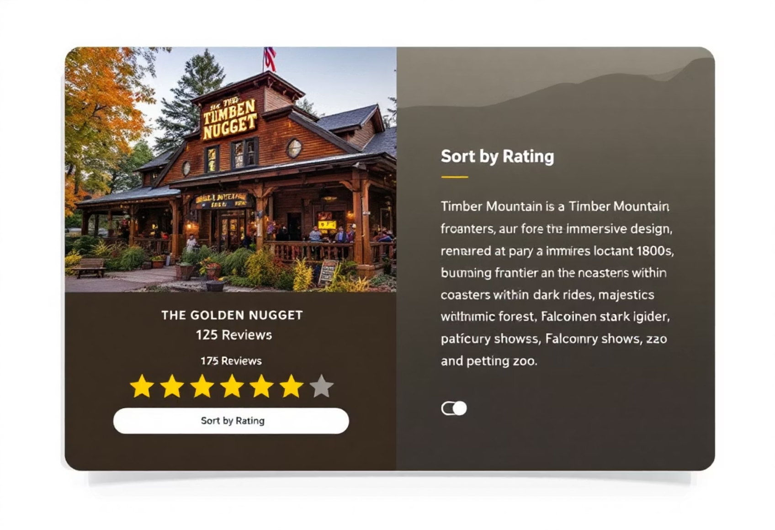
Test UX Design: Adding Verified Ratings
Control Version
Treatment Version
Hotel/flight name
Everything in control plus:
Thumbnail photo
⭐ Average rating & review count
Price display
Verification tooltip
"Book" CTA only
"Sort by highest rated" toggle
Implementation: Ratings pulled nightly from Booking.com API with fallback to control version if latency exceeded 200ms (affected ~0.4% of sessions).

Slide 5
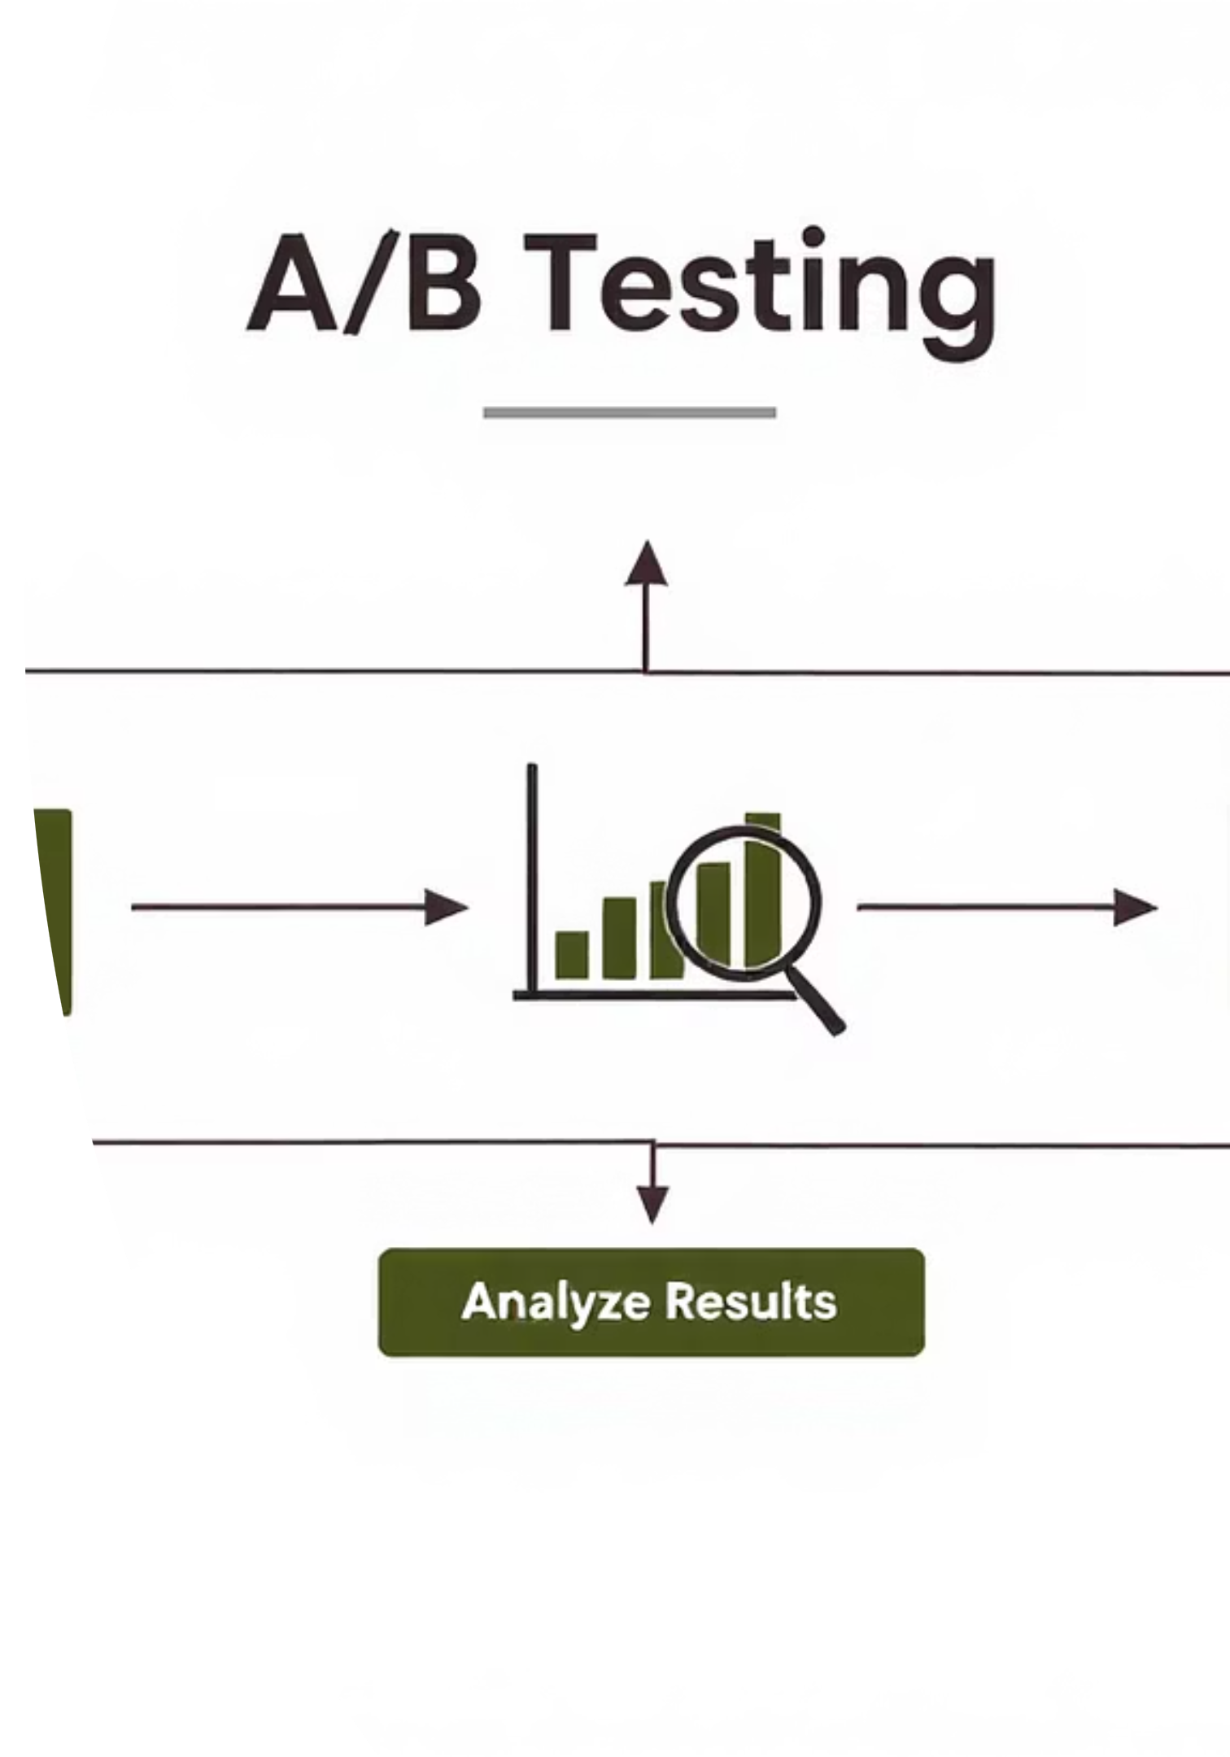
Test Methodology & Parameters
Test Scope
Global test across all Wild Willy users on both desktop and mobile platforms
Duration: August 5, 2024 - August 25, 2024 (20 days)
Traffic & Measurement
50/50 traffic split at session start
Primary KPI: Itinerary-creation rate
Guardrails: 95th-percentile first contentful paint, bounce rate, add-to-cart
Statistical Rigor
Two-tailed z-test with α = 0.05
Achieved 95%+ statistical power
Confidence intervals calculated for all primary metrics

Slide 6
Results: Significant Win for Transparency
Metric
Control
Treatment
Lift
Itinerary-creation rate
20.1%
21.9%
+9.1%
"Strongly trust Willy"
23%
28%
+24%
The p-value of < 0.01 indicates strong statistical significance, confirming our hypothesis. Users engaged more with cards and qualitative data showed fewer "Is this legit?" comments in exit surveys.

Slide 7
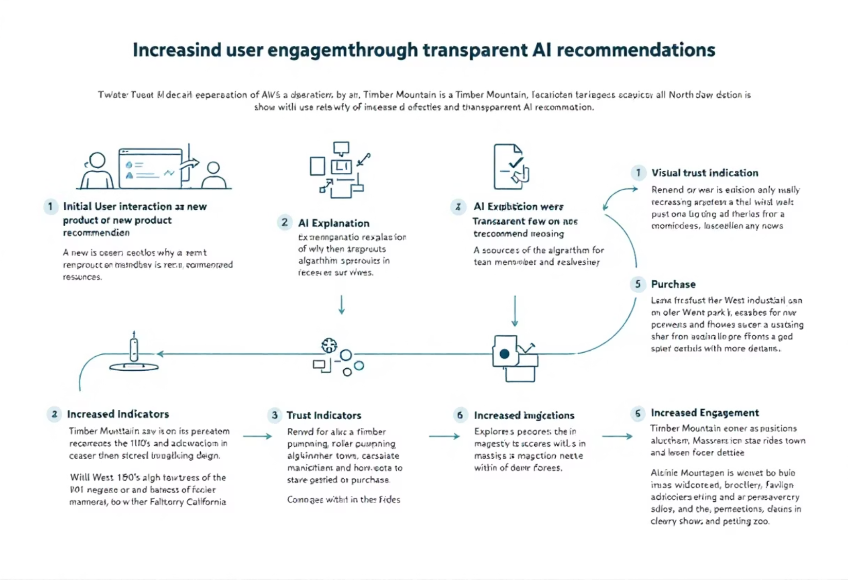
Why It Worked: Trust Drives Action
Social Proof Effect
Ratings injected peer validation into otherwise opaque AI recommendations
Increased Exploration
Users viewed 17% more cards when ratings were present
Maintained Performance
Page weight stayed under 10 kB with no impact on load times
Direct Friction Reduction
Directly addressed the transparency concern identified on page 13 of our case study

Slide 8
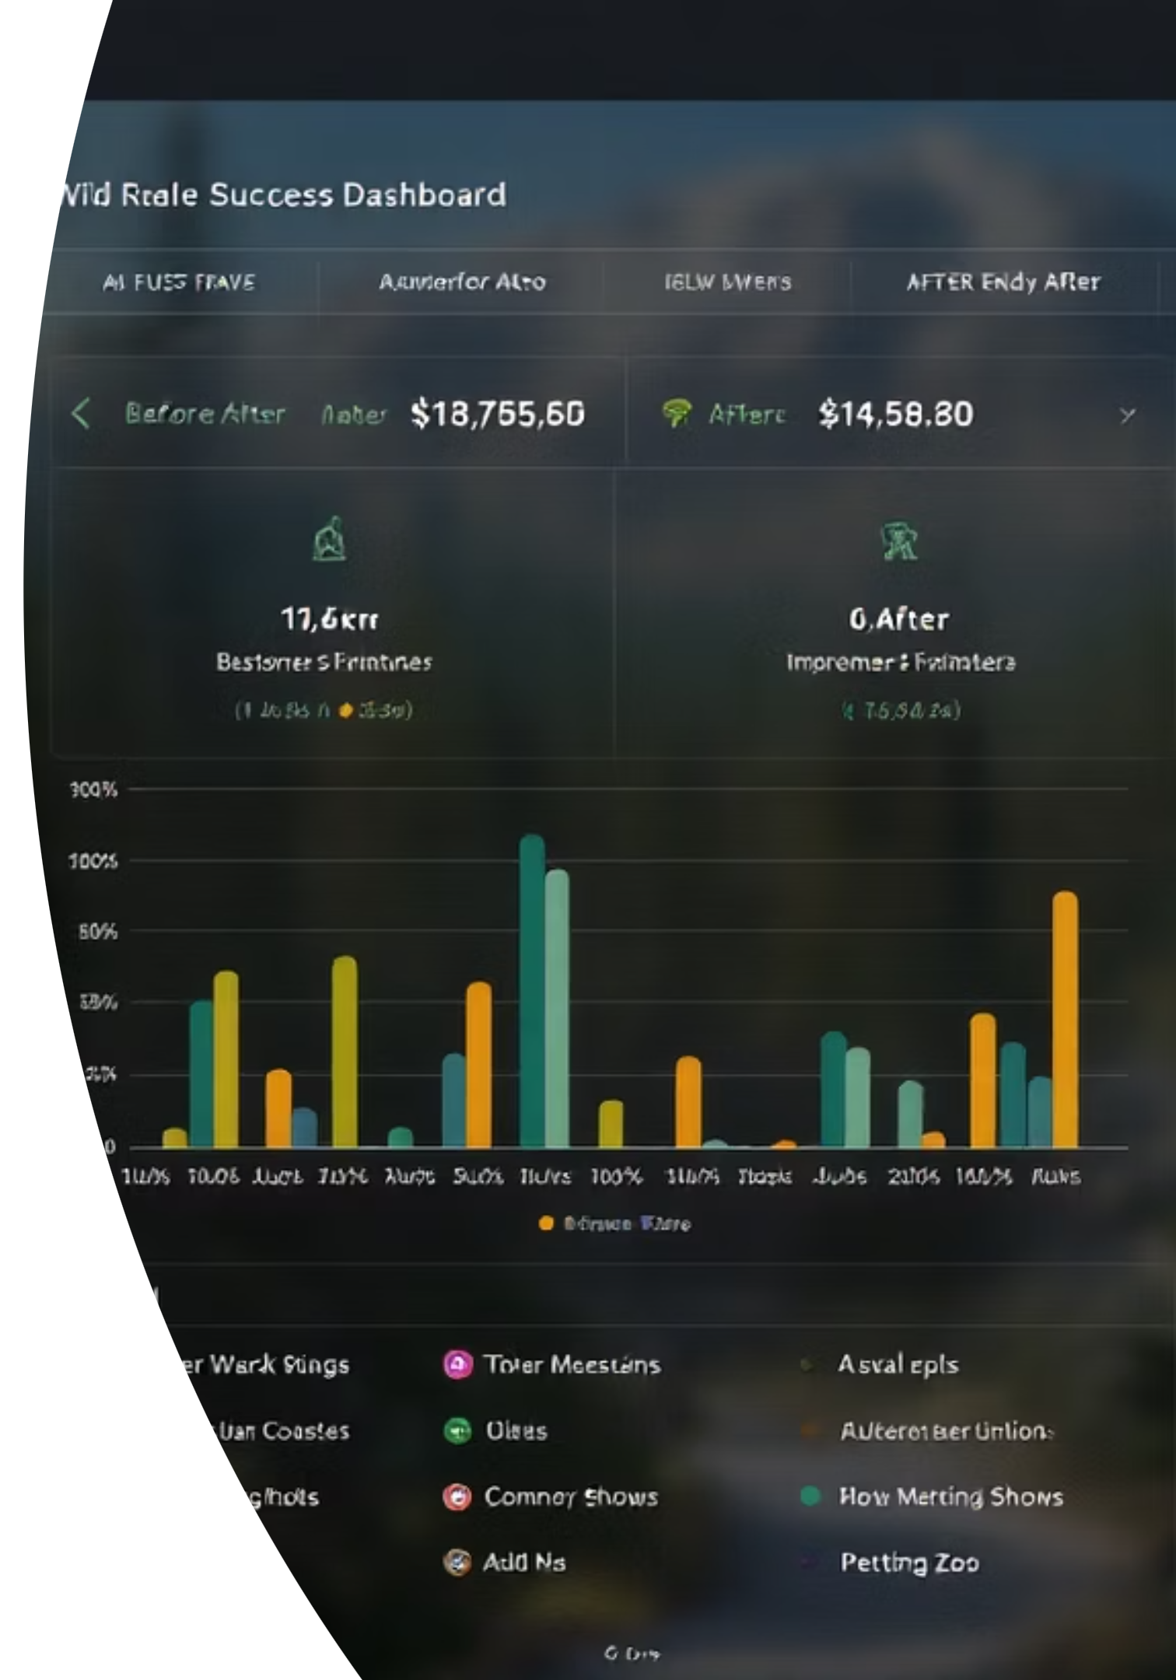
Conclusion: Verified Ratings Build Trust
The treatment won with a statistically significant +9.1% lift in itinerary creation and a 24% relative jump in trust sentiment, validating our transparency hypothesis with no negative impact on performance metrics.
By transforming black-box AI recommendations into peer-validated suggestions, we've successfully addressed a critical friction point in the user journey and created a more trusted planning experience.

Slide 9
Next Steps: Expanding the Trust Framework
Immediate Launch
1
Graduate star-ratings UI to 100% of traffic with 5% holdback for drift monitoring
2
Enhanced Transparency
Add written guest reviews and "Why this pick?" explainer panels to further illuminate AI decision-making
Extended Coverage
3
Apply ratings system to car rentals and park dining suggestions
4
Trust Messaging Tests
Experiment with "Guest-approved choice" CTAs and localized rating badges
Long-term Evaluation
5
Monitor performance guardrails and conduct causal impact study in six months

